Slide 1
Solar Thermal systems
Flat plate collector:

Slide 2
Flat Plate Collector consists of four essential components:
An absorber plate.
It intercepts and absorbs solar radiation.
This plate is usually metallic (copper, aluminium or steel), although plastics have been used in some low temperature applications.
In most cases it is coated with a material to enhance the absorption of solar radiation.
The coating may also be tailored to minimize the amount of infrared radiation emitted.
A heat transport fluid (usually air or water) is used to extract the energy collected and passes over, under or through passages which form an integral part of the plate.
Transparent covers.
These are one or more sheets of solar radiation transmitting materials and are placed above the absorber plate.
They allow solar energy to reach the absorber plate while reducing convection, conduction and re-radiation heat losses.
Insulation beneath the absorber plate.
It minimizes and protects the absorbing surface from heat losses.
Box-like structure. It contains the above components and keeps them in position.

Slide 3
A selective surface should possess the following characteristics:
Its properties should not change with use;
It should be of reasonable cost
It should be able to withstand the temperature levels associated with the absorber plate surface of a collector over extended period of time;
It should be able to withstand atmospheric corrosion and oxidation.
Some selective coatings are:
Black chrome;
Black nickel;
Black copper;
Silver foil;
Enersorb (nonselective);
Nextel (non-selective).

Slide 4
Materials for flat-plate collectors:
Absorber plate: Copper, Aluminium, Steel, Brass, Silver etc.
Insulation: Crown white wool, Glass wool, Expanded polystrene, foam etc.
Cover plate: Glass, Teflon, Tedlar, Marlex etc.
Selective Absorber Coatings/Surfaces
In order to reduce thermal losses from the absorber plate of a solar heating panel, an efficient way is to use selective absorber coatings.
An ideal selective coating is a perfect absorber of solar radiation as well as a perfect reflector of thermal radiation.
A selective coating, thus, increases the temperature of an absorbing surface.
A “selective surface” has a high absorptance for shortwave radiation (less than 2.5 mm) and low emittance of longwave radiation (more than 2.5 mm).

Slide 5
Various types of flat-plate collectors have been designed and studied.
These include
tube in plate, corrugated type, spiral wound type etc.
Other criteria is
single exposure, double exposure or exposure and reflector type.
The collector utilizes sheets of any of the highly conducting material viz. copper, aluminium, or galvanized iron.
The sheets are painted dead black for increasing the absorptivity.
The sheets are provided with one or more glass or plastic covers with air gap in between to reduce the heat transfer losses.
The sides which are not exposed to solar radiation are well insulated.
The whole assembly is fixed in airtight wooden box which is mounted on simple device to give the desired angle of inclination.
The dimensions of collectors should be such as to make their handling easy.
The collector will absorb the sun energy (direct as well as diffused) and transfer it to the fluid (air, water or oil) flowing within the collector.

Slide 6
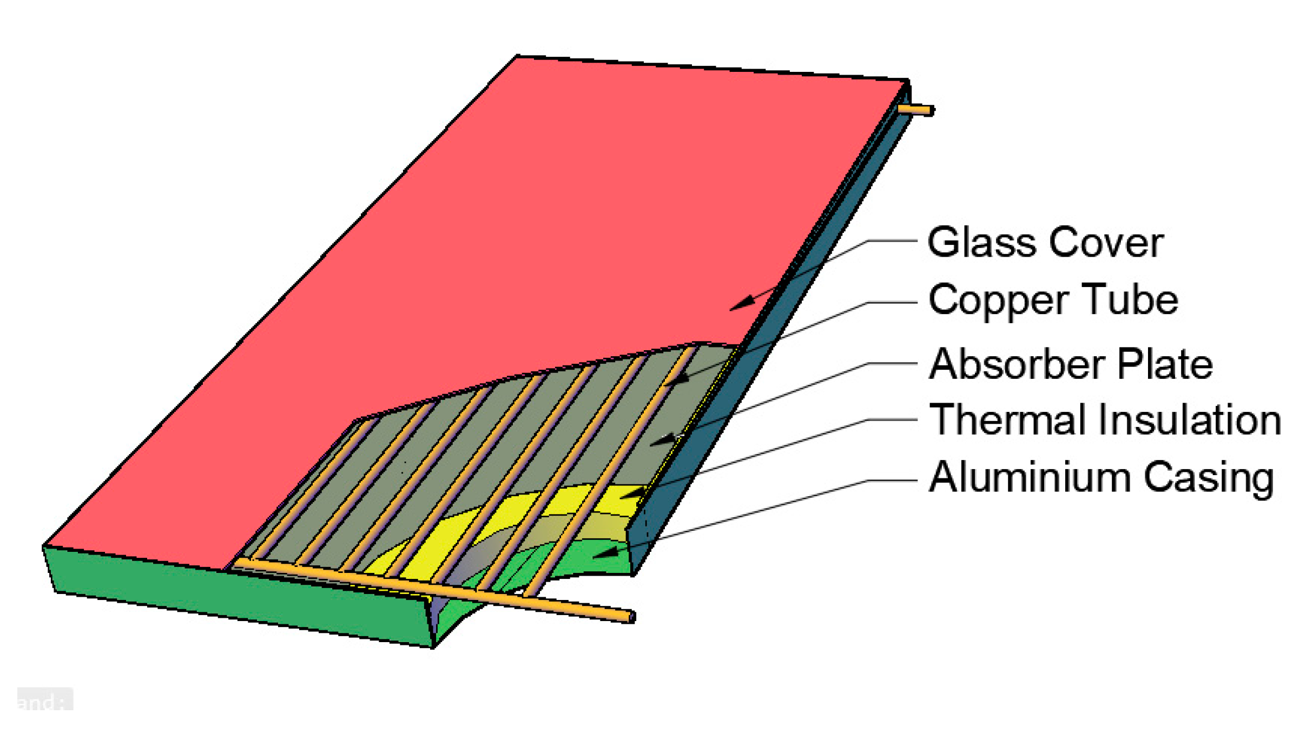

Slide 7
Basically, a flat-plate collector is effective most of time, reliable for good many years and also inexpensive.
Use of flat mirrors in the flat-plate collectors improves the output, permitting higher temperatures of operation.
Side mirrors are used either at north and south edges or at east and west edges of the collector or a combination of both. The mirrors may be of reversible or non-reversible type.
Factors affecting the performance of a flat-plate collector::
Incident solar radiation:
The collector’s efficiency is directly related to solar radiation falling on it and increases with rise in temperature.
Number of cover plates:
The increase in number of cover plates reduces the internal connective heat losses but also prevents the transmission of radiation inside the collector
Spacing between absorber plate and glass cover.
The more the space between the absorber and the cover plate, the less is the internal heat loss.

Slide 8
Tilt of the collector.
In order to achieve better performance, flat-plate collector should be tilted at an angle of latitude of the location.
The collector is placed with south facing at northern hemisphere to receive maximum radiation throughout the day.
Selective surface:
The selective surface should be able to withstand high temperature, should not oxidize and should be corrosion resistant.
Fluid inlet temperature:
With the increase in the inlet temperature of the fluid, there is an increase in operating temperature of the collector and this leads to decrease in efficiency.
Dust on cover plate:
The collector’s efficiency decreases as dust particles increase on the cover plate. Thus, frequent cleaning is required to get the maximum efficiency of the collector.

Slide 9
Advantages of Flat-plate Collectors:
Both beam and diffuse solar radiations are used.
Require little maintenance.
The orientation of the sun is not required (i.e. no tracking device needed)
Mechanically simpler than the focusing collectors.
Disadvantages of Flat-plate Collectors:
Low temperature is achieved.
Heavy in weight.
Large heat losses by conduction due to large area.
Applications:
Used in solar water heating.
Used in solar heating and cooling.
Used in low temperature power generation.

Slide 10
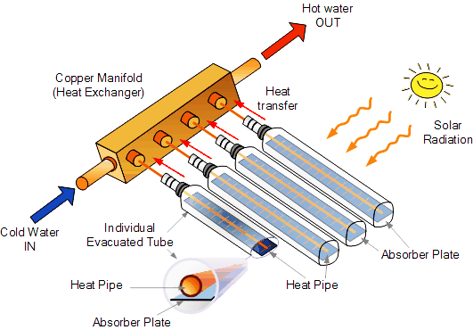
Evacuated Collectors:

Slide 11
Evacuated Collectors:
Planar solar collectors of evacuated type often achieve efficiencies with an output temperature of above 80°C.
In these devices a vacuum occupies the space between the absorber and the aperture cover.
The absorber may consist of a heat pipe that is thermally bonded to collecting this, possibly in an evacuated glass tube.
In 1983 Collins and Duff, stated that, the efficiencies in excess of 40% or an output temperature of 200°C can be reached.
Problem 1:
The following data relate to a flate plate collector used for heating the building: Location and latitude = Baroda, 22°N; Day and time: January 22,11:30 – 12:30 (IST); Annual average intensity of solar radiation = 340 W/m2 hr; Tilt of the collector = latitude + 14°; Number of glass covers = 2; Heat removal factor for collector = 0.82; Transmittance of glass = 0.87; Aborptance of glass = 0.89; Top loss coefficient for collector = 7.9 W/m2 hr °C; Collector fluid inlet temperature = 48 °C; Ambient temperature = 16 °C.
Calculate the following:
Solar altitude angle;
Incident angle;
Efficiency of the collector.

Slide 12
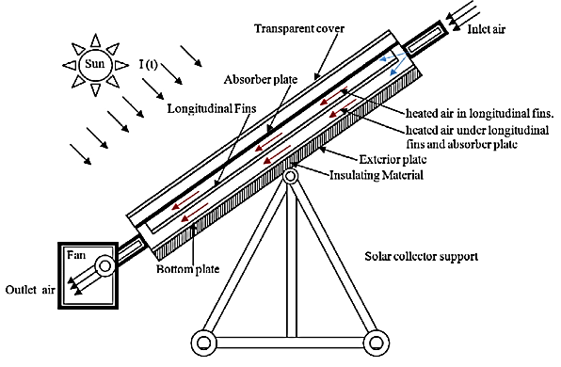
solar air collector:

Slide 13
solar concentrator:
What does a solar concentrator do?
A solar concentrator uses lenses, called Fresnel lenses, which take a large area of sunlight and direct it towards a specific spot by bending the rays of light and focusing them.
Some people use the same principle when they use a magnifying lens to focus the Sun's rays on a pile of kindling or paper to start fires.

Slide 14
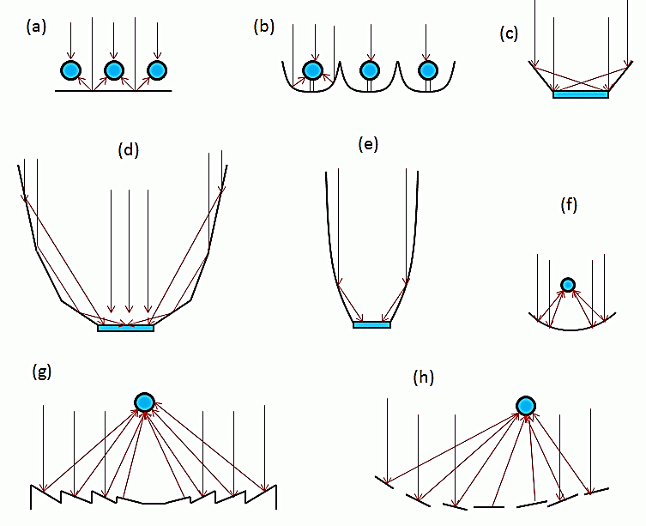
Types of concentrating sunlight collectors:
tubular absorbers with diffuse back reflector,
tubular absorbers with specular cusp reflectors,
plane receiver with plain reflectors (V-trough),
Multi-sectional planar concentrator,
compound parabolic concentrator
parabolic trough,
fresnel concentrator, (a flat lens made of a number of concentric rings, to reduce spherical aberration)
array reflectors (heliostats) with central receiver.
Concentration of light on the receiver is achieved by shaping the reflectors (mirrors) around the receiver (represented by blue circles).

Slide 15
Solar distillation
Solar distillation is by far the most reliable, least costly method of 99.9% true purification of most type of contaminated water especially in developing nations, where fuel is scarce or too expensive.
Solar distillation is used to produce drinking water or to produce pure water for lead acid batteries, laboratories, hospitals and in producing commercial products such as rose water.
The basic principles of Solar water distillation are simple yet effective, as distillation replicates the way nature makes rain.
The sun’s energy heats water to the point of evaporation.
As the water evaporates, water vapor rises, condensing on the glass surface for collection.
This process removes impurities such as salts and heavy metals as well as eliminates microbiological organisms.
The end result is water cleaner than the purest rainwater.
The Sola Aqua still is a passive solar distiller that only needs sunshine to operate.
There are no moving parts to wear out.

Slide 16
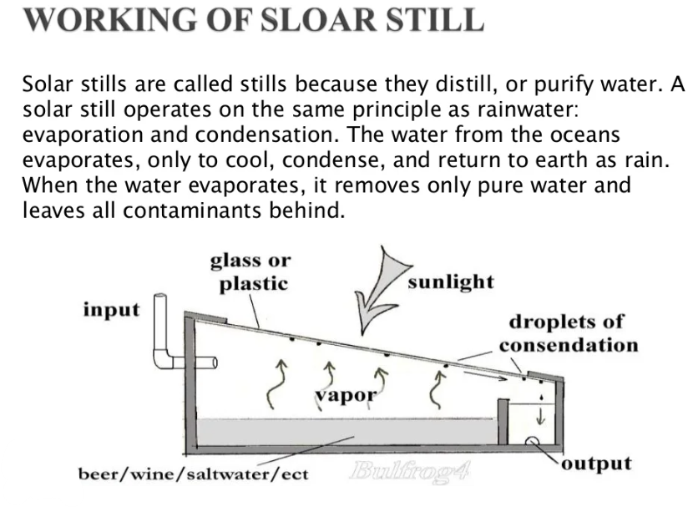

Slide 17
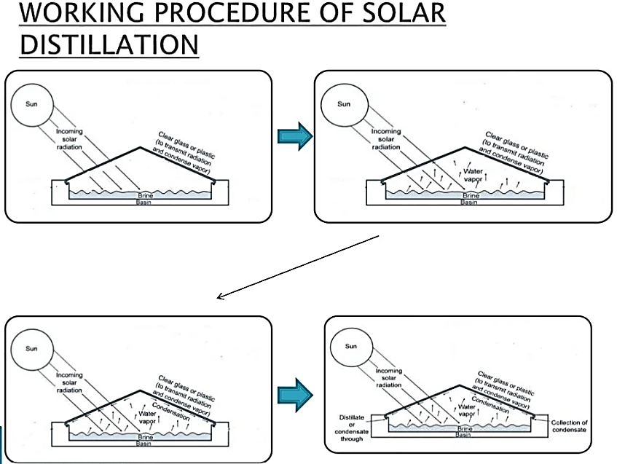

Slide 18
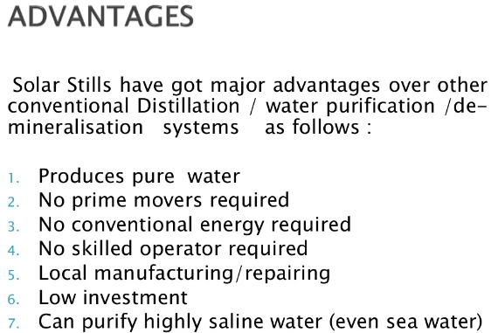

Slide 19
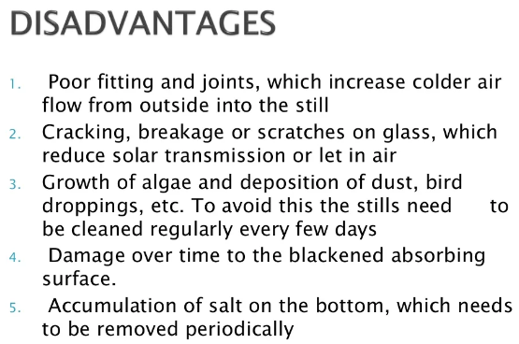

Slide 20
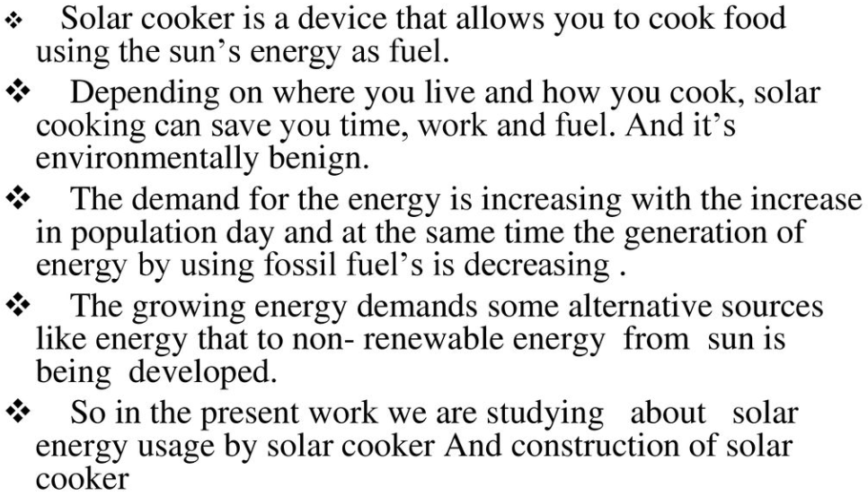
Solar Cooker

Slide 21
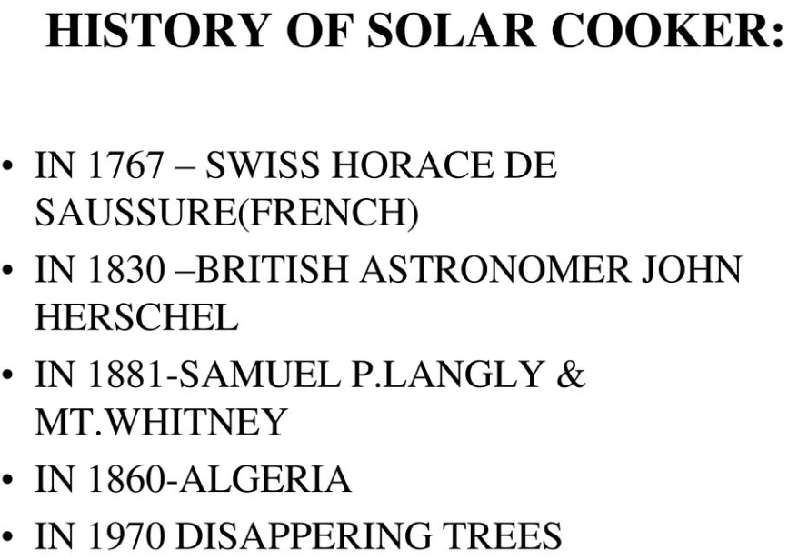

Slide 22
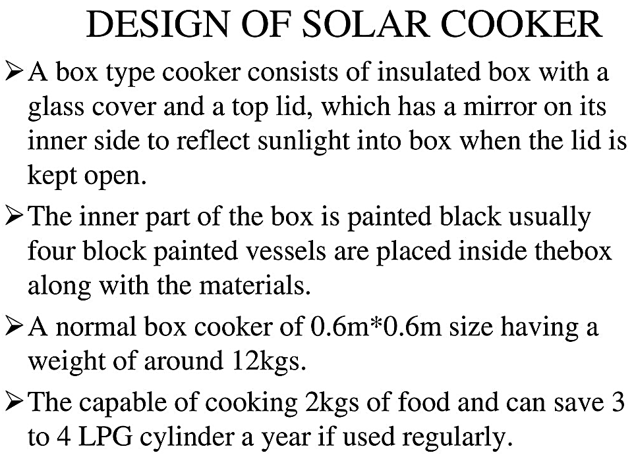

Slide 23
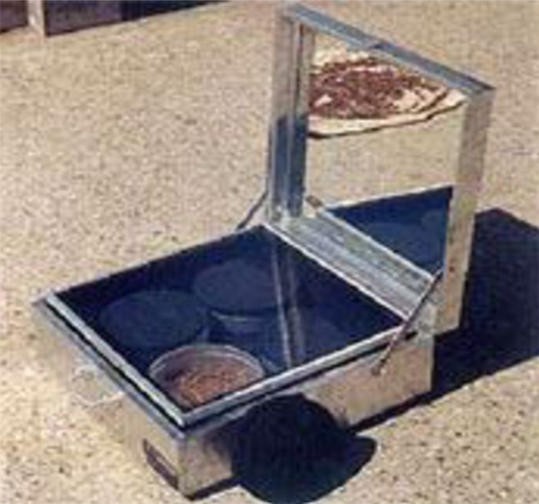
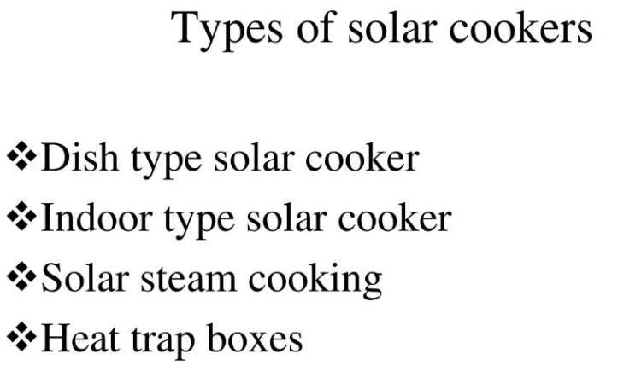

Slide 24
